Slide 1
Pizza Sales Analysis Insights and Recommendations
Presented by: [SEELAM SATYA SAI SHIVA RAMA KRISHNA]

Slide 2
CONTENTS
Understand sales trends and performance metrics
Identify high-performing and underperforming products
Total Revenue, Average Order Value, Total Pizza Sales
Total Orders
4. Daily Averages (Sales & Revenue), Sales Distribution
(Size & Category)

Slide 3
Table of contents
Introduction to Pizza Sale Analysis……………..01
Total Revenue Calculation…………………………02
Average Order Value…………………………………03
Total Pizza Sales………………………………………..04
Total Orders Overview………………………………05
Average Sales Per Day……………………………….06
Total Revenue Per Day……………………………….07
Sales Distribution by Pizza Size…………………..08
Pizza Sales by Category……………………………….09
Top 5 Pizzas by Revenue………………………………10

Slide 4
Bottom 5 Pizzas by Revenue…………11
Top 5 Pizzas by Quantity Sold……….12
Summary of Key Insights………………13

Slide 5
Introduction to Pizza Sale Analysis
Introduction to Pizza Sale Analysis
Understanding key performance indicators is essential for evaluating pizza sales. This analysis focuses on metrics such as total revenue, average order value, and total pizza sales to provide insights into customer behavior and business performance.
Utilizing SQL queries and Power BI DAX functions allows for a comprehensive examination of sales data. This approach aids in identifying trends, optimizing menu offerings, and enhancing marketing strategies based on customer preferences and purchasing patterns.
The analysis covers various aspects, including total revenue generated from pizza sales, breakdown of sales by pizza size and category, and identification of top and bottom-performing pizzas to inform future business strategies.
By leveraging data analysis, businesses can make informed decisions that drive growth and improve customer satisfaction in the competitive pizza market.

Slide 6
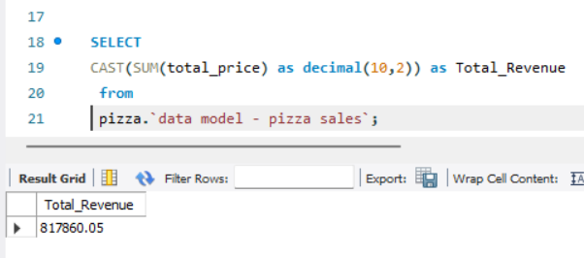
Total Revenue Calculation
This query calculates the total income generated by all pizza sales. It sums up the product of quantity sold and the price per pizza across all orders. Understanding total revenue is critical for assessing the overall business performance and identifying growth trends.
Totla _Revenue:- 817860.05

Slide 7
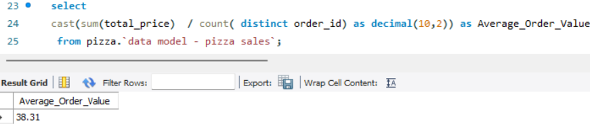
iAverage order value
This query computes the average revenue generated per order. It divides the total revenue by the total number of orders. Average order value helps evaluate customer purchasing behavior and the effectiveness of sales strategies

Slide 8
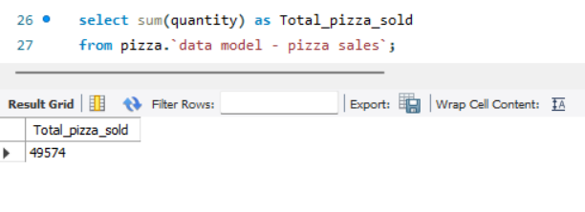
Total Pizza Sales
This query aggregates the total number of pizzas sold. By summing up the quantities, this metric provides insights into customer demand and helps in inventory planning.

Slide 9
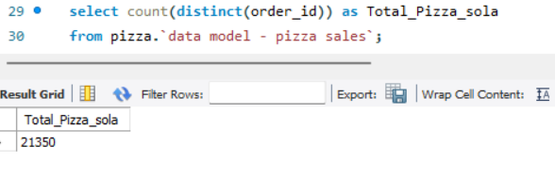
Total Orders
This query counts the total number of orders placed. Tracking the total orders over time can reveal customer engagement levels and order frequency trends.

Slide 10
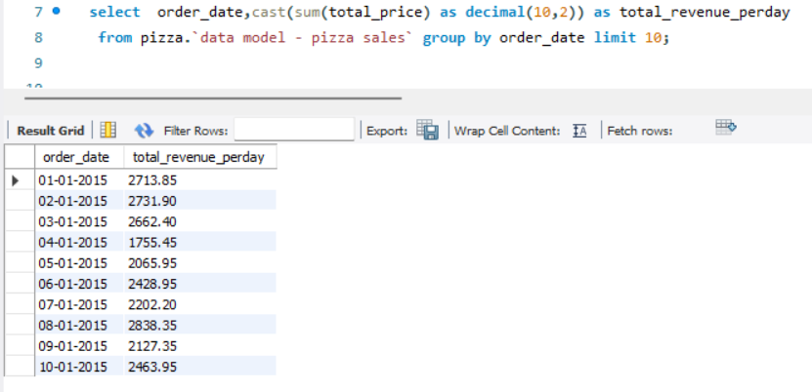
Total Revenue Per Day
This query determines the average daily income from sales. It helps in setting revenue targets and measuring how consistent daily sales are with long-term goals.

Slide 11
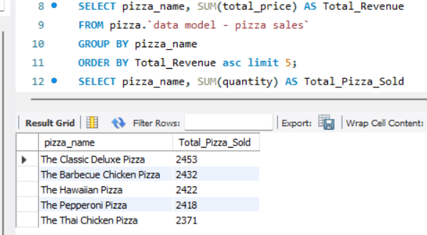
Total Revenue Per Day Top 5 Pizzas by Quantity Sold
This query determines the average daily income from sales. It helps in setting revenue targets and measuring how consistent daily sales are with long-term goals.
This query finds the pizzas with the highest sales volume. It identifies customer favorites, which can be emphasized in advertising or included in combo deals.

Slide 12
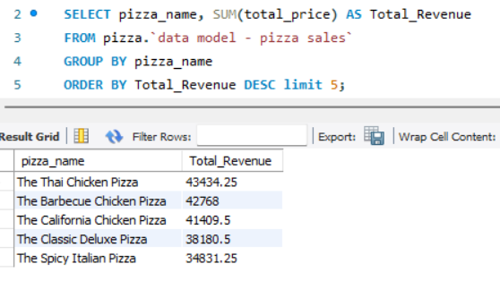
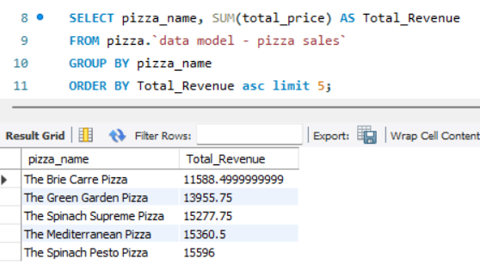
Top 5 Pizzas by Revenue:-
Bottom 5 Pizzas by Revenue
This query identifies the highest-earning pizzas.Knowing which pizzas generate the most revenue helps in menu optimization and focused promotions.
This query highlights the pizzas contributing the least to revenue. It can guide decisions on discontinuing underperforming items or redesigning them to increase appeal.

Slide 13
THANK YOU

